Slide 1
secret life of machines
RAY LC

Slide 2
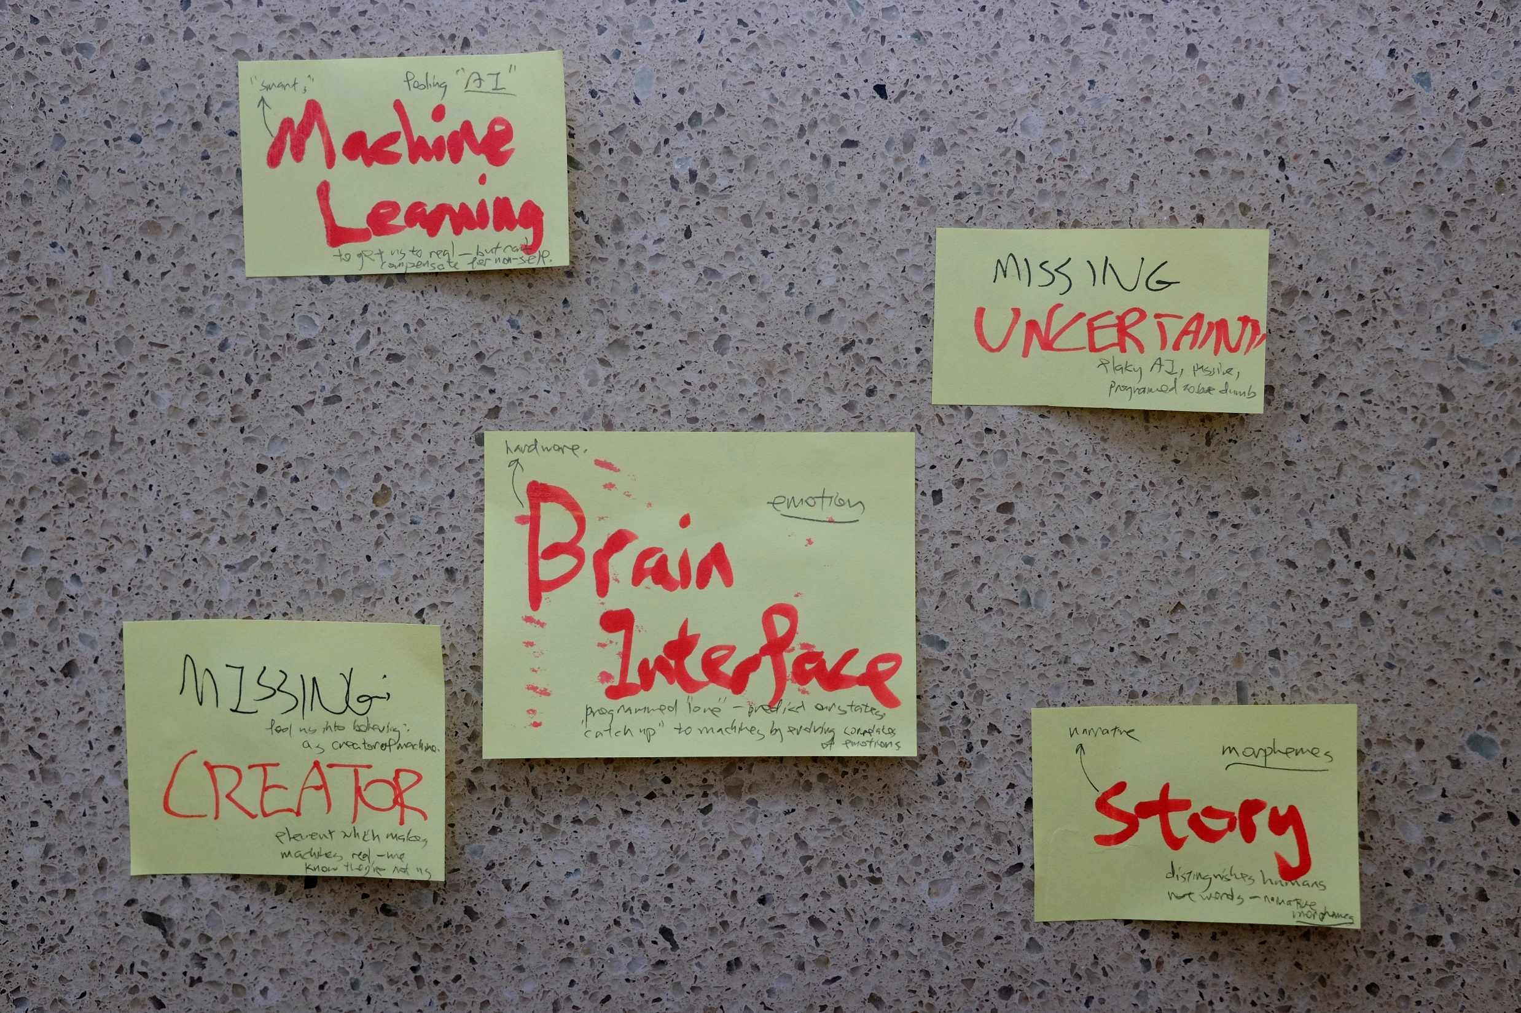

Slide 3
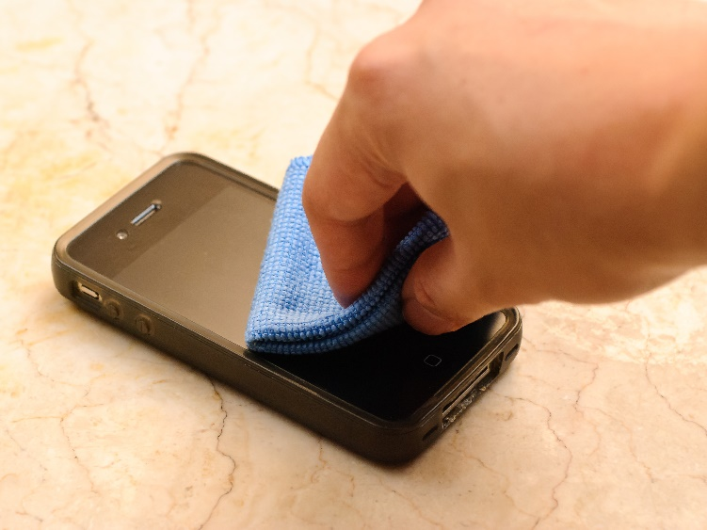
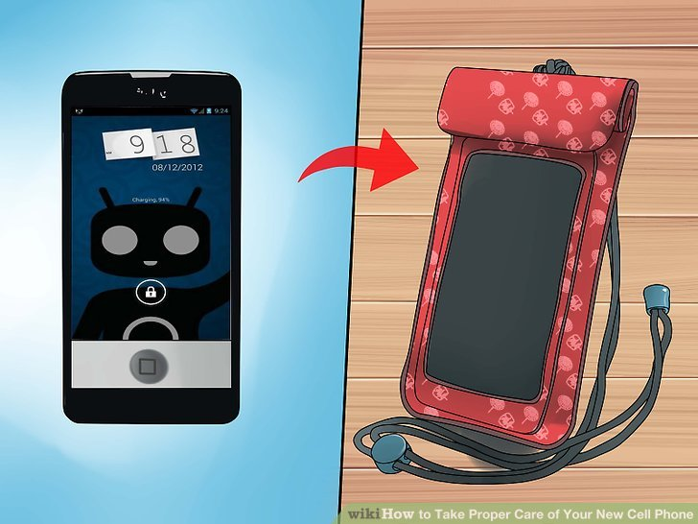
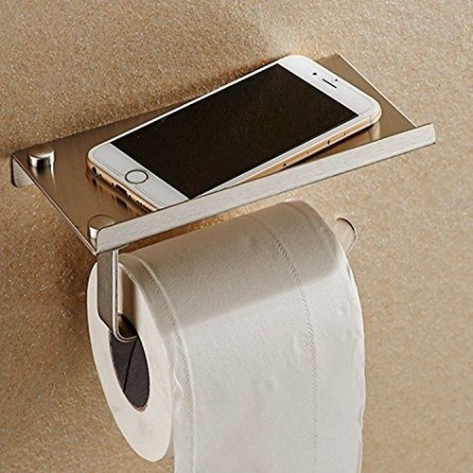
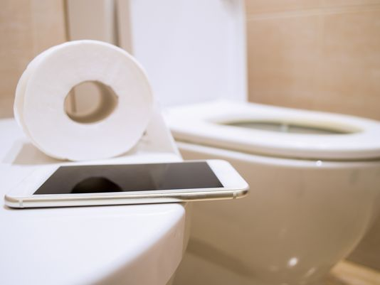


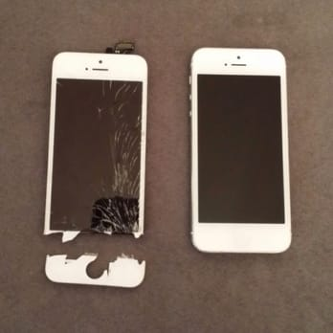
◦
1D
2D
3D
4D
5D
◦

Slide 4


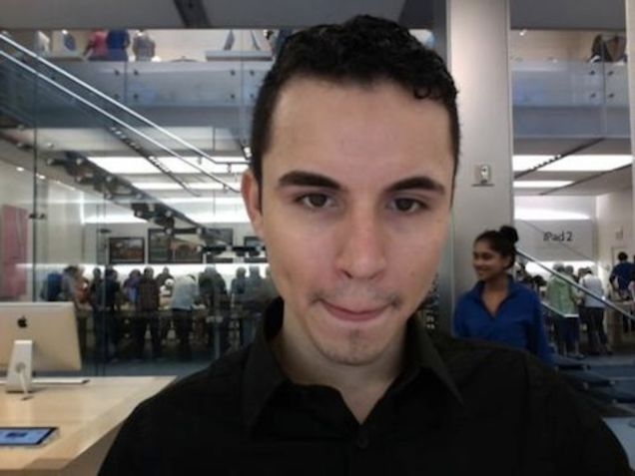
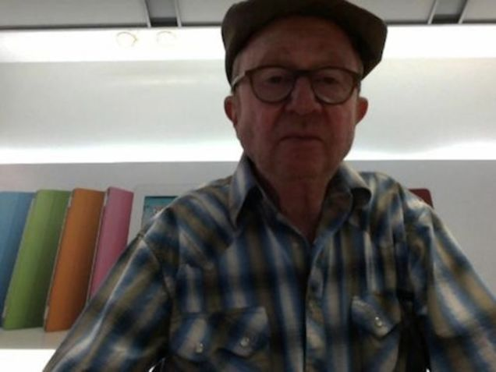
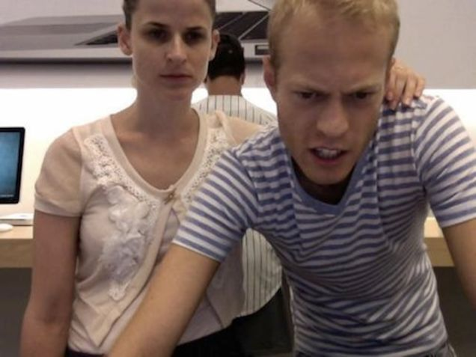
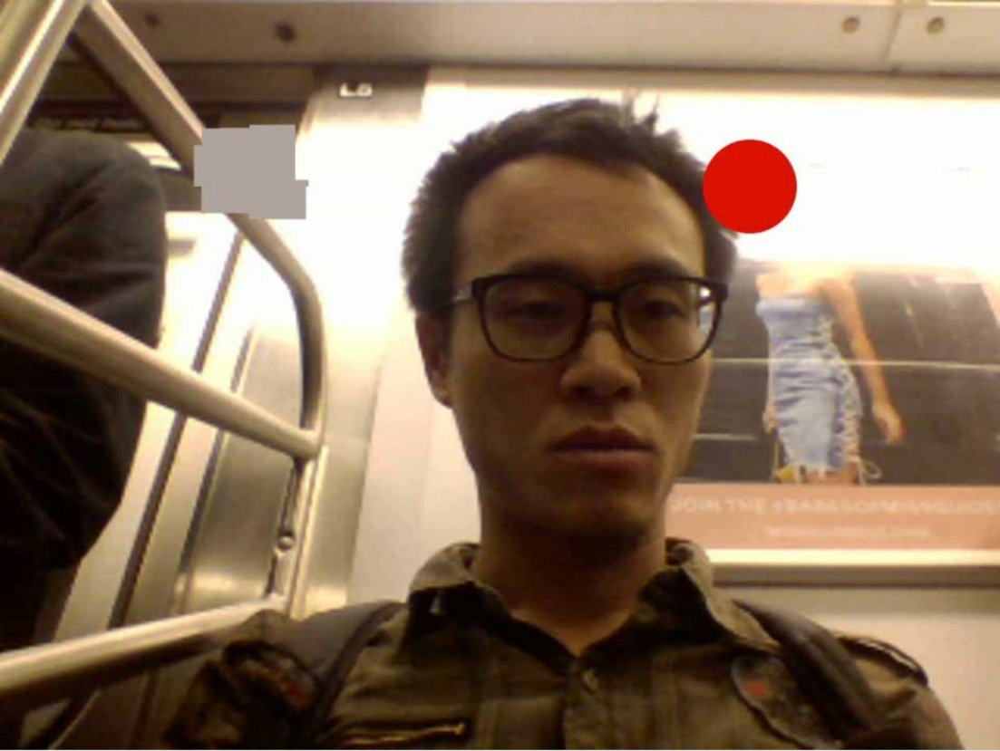
◦
1D
2D
3D
4D
5D
◦

Slide 5
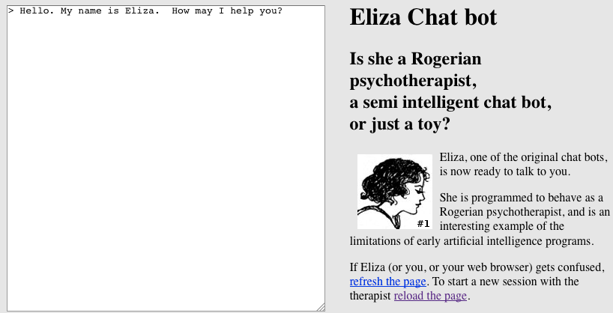
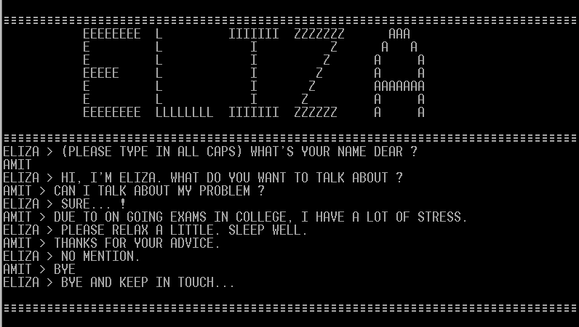
◦
1D
2D
3D
4D
5D
◦
Immediate feedback
is not 4D!

Slide 6
time (implicit) perception in a chatbot
How time encodes subjective perception? User test!
Random delays don’t make sense.
Delay that scales to the user’s response only works for meaningful responses.
Delay that reflects subject matter requires understanding of human practices.
Delay that scales + occasional random long -> cute!!!

Slide 7


Slide 8

◦
1D
2D
3D
4D
5D
◦

Slide 9
feedback
Really show what different time delays are led from different parameters – show the invisible
Introduce random typos in the chatbot reply
Karin therapy app
Scale time delay with what content chatbot is saying for realism

